Slide 1

Immigration Dataset EDA
DAVID BERBERENA
DSC 530 Data Exploration and analysis
Iranitalab winter 2023-2024

Slide 2
Immigration has been a topic of great controversy among many American citizens, yet there is little talk of any data related to this topic and what this data could tell us about the truth concerning the country illegally housing undocumented aliens.
What can we find out about immigrants through exploratory data analysis?

Slide 3
Hypothesis Generation
After finding a dataset on Kaggle concerning American immigration statistics from the Department of Homeland Security, I was rather intrigued. Upon seeing the data, I have formulated a hypothesis that will guide me during the EDA process. My question is as follows:
Does an increase in the number of people entering the country seeking refuge lead to an increase in immigrants with permanent residency in the United States?
My data exploration will seek to answer this question and shed more light on the immigration situation the country has faced for the past 40 years.

Slide 4
Immigration Dataset Variables
The dataset from the Department of Homeland Security contains the following variables:
Year – Years that the observations took place, ranging from 1980 to 2021
Immigrants Obtaining Lawful Permanent Resident Status - Number of immigrants who obtained lawful permanent resident status in the United States, otherwise known as green card holders.
Refugee Arrivals - Number of refugees who arrived in the United States. Excludes Amerasian immigrants except for the fiscal years of 1989 and 1991. Figures are based on the refugee's arrival date.
Noncitizen Apprehensions - Number of noncitizens apprehended in the United States. Data from 2020 to 2021 includes U.S. Customs and Border Protection (CBP) encounters that resulted in expulsion on public health grounds (due to the pandemic).
Noncitizen Removals - Number of noncitizens removed from the United States. Removals are the compulsory and confirmed movement of an inadmissible or deportable noncitizen out of the United States based on an order of removal.
Noncitizen Returns - Number of noncitizen returns from the United States. Returns are the confirmed movement of an inadmissible or deportable noncitizen out of the United States not based on an order of removal.

Slide 5
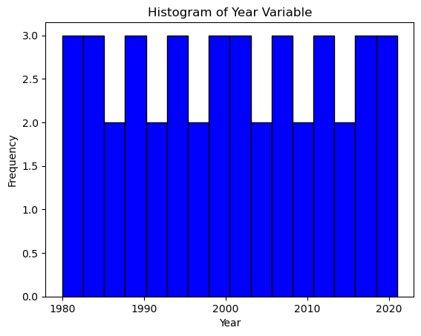
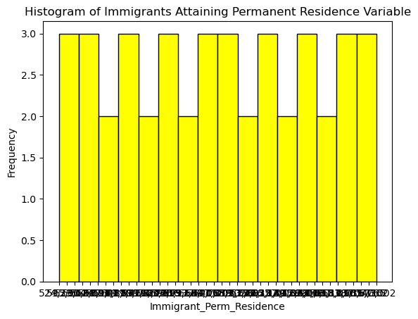
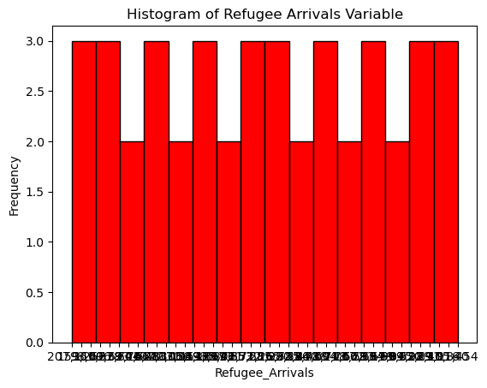
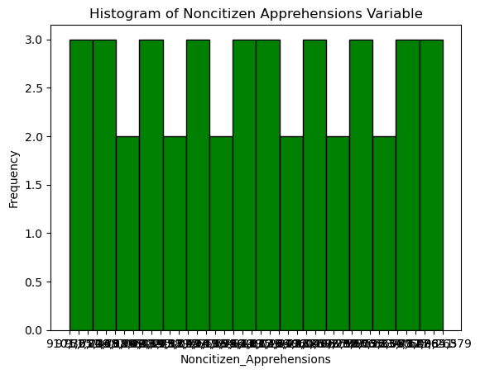
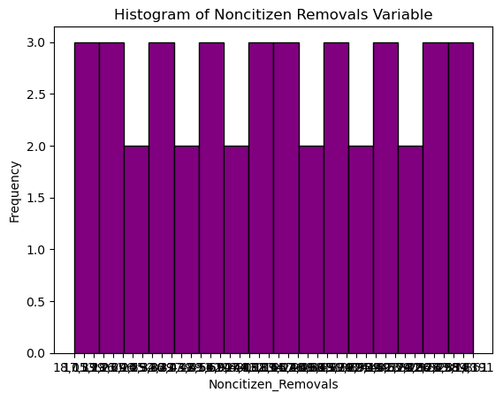
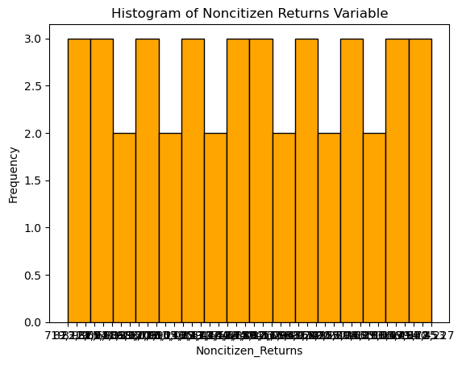
Histograms of Each Variable

Slide 6
Outlier Data Strategy
Looking at the various histograms and scatter plots that have been made of the dataset, there are certainly outlier data points that encourage further investigation. The years 1989 through 1991 saw an abnormal amount of immigrants obtaining green cards, and additional research has shown that this was because of the proposal and subsequent signing of the Immigration Act of 1990 into law. This law called for a significant increase in the number of permanent immigrants allowed within the United States, and refugees responded in kind.
In terms of the actual outlier data points, the year 1990 brought in 1.5 million immigrants obtaining green cards, and 1991 saw 1.8 million immigrants solidify their residencies, while all other years in the dataset do not eclipse 1.3 million. These outlier data points are to be scrutinized carefully and potentially removed if they cause the dataset to be too noisy.

Slide 7
Dataset Variable Descriptive Stats
Year Variable
Mean: 2000.5
Mode: N/A
Variance: 146.91666
Standard Deviation: 12.12091
Skewness: 0.0
Kurtosis: 0.12375
Immigrant Permanent Residence Variable
Mean: 914286.11904
Mode: N/A
Variance: 76394664111.00964
Standard Deviation: 276395.84676
Skewness: 0.77716
Kurtosis: -0.47320
Refugee Arrivals Variable
Mean: 73705.33333
Mode: N/A
Variance: 1361549050.07936
Standard Deviation: 36899.17411
Skewness: 1.163323
Kurtosis: 0.30865

Slide 8
Descriptive Stats Continued
Noncitizen Apprehensions Variable
Mean: 1136983.09523
Mode: N/A
Variance: 116733654540.70522
Standard Deviation: 341663.07166
Skewness: 0.38425
Kurtosis: 0.37110
Noncitizen Removals Variable
Mean: 179951.14285
Mode: N/A
Variance: 20592427742.69388
Standard Deviation: 143500.61931
Skewness: 0.27338
Kurtosis: 0.10741
Noncitizen Returns Variable
Mean: 846411.57142
Mode: N/A
Variance: 228136998579.72107
Standard Deviation: 477636.8898
Skewness: -0.16288
Kurtosis: -0.41063

Slide 9
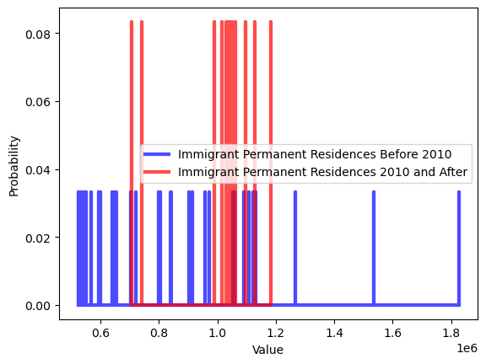
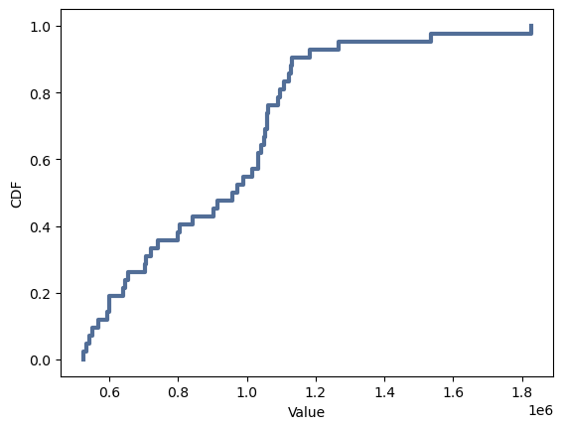
PMF and CDF Plots

Slide 10
Cumulative Distribution Function Analysis
After plotting the cumulative distribution function (CDF) of the permanent residence variable, I was able to see the probability of a randomly chosen data point being less than or equal to a given x-value. The fact that the CDF curve is large indicates that the data points attributed to the permanent residence variable are spread over a larger range of values.
Regarding my hypothesis question, this CDF alone does not grant me much information that could be used to get closer to an answer. This is because my scenario involves another variable that predicts a change in the outcome variable in question, which is the number of immigrants who are granted permanent residency. CDF offers a look into the probabilities of a random value being equal to less than specified values in the dataset. CDF addresses probability, yet my hypothesis question needs a correlation metric to offer insight.

Slide 11
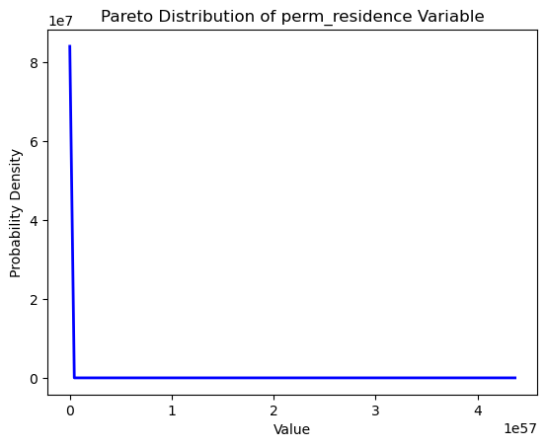
Pareto Distribution Plot and Analysis
The Pareto distribution that I have performed on the permanent residence variable helps to illustrate the 80-20 rule. This concept is applied to the dataset to realize that 20% of the years this dataset contains contributes about 80% of the impact of immigrants obtaining permanent residences. The years in the 20% contain high immigration numbers while the other 80% hold low immigration numbers. As my hypothesis question deals with correlation, the Pareto distribution may be able to show that 80% of whatever correlation the permanent residence variable has to the refugee variable can be explained by 20% of the observations.

Slide 12
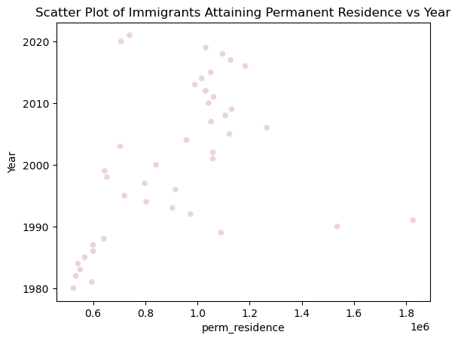
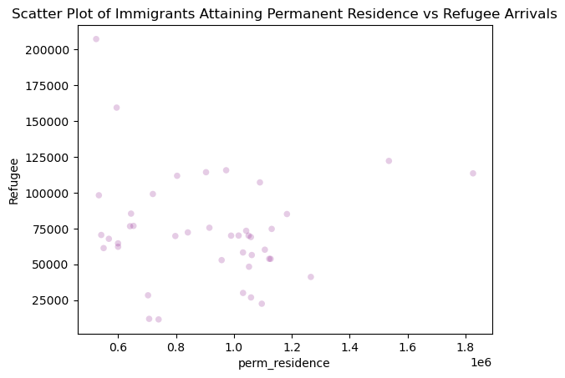
Variable Scatter Plots for Correlation

Slide 13
Correlation/Causation Statistics
For the hypothesis that has been generated, these metrics are potentially the most important. For this analysis, I computed the covariance, Pearson correlation, and Spearman correlation for the permanent residence and year variables and the permanent residence and refugee variables. As my hypothesis focuses solely on the latter combination, I will list the metrics only for that pairing:
Covariance: -746073778.611111
Pearson's correlation coefficient: -0.07315324874933309
Spearman's correlation coefficient: -0.16635604894254924
All of these metrics point to a weak and negative relationship between the permanent residence and refugee variables. Each statistic has a negative value, and Pearson’s correlation is very close to 0, showing almost no correlation. Spearman’s correlation takes into account the potential for non-linear relationships, yet still yields a weak and negative correlation coefficient.

Slide 14
Correlation Test Results
Using the CorrelationPermute() function in thinkstats2, I conducted a correlation test with both the permanent residence and refugee variables to see the probability of the Pearson correlation coefficient occurring again solely by chance given that the data is permutated and computed multiple times. The results are as follows:
P-value: 0.648 – This value shows that there is a 64.8% probability that the correlation coefficient has been realized by chance alone and that the null hypothesis of there being no correlation between these two variables cannot be rejected due to not enough supporting evidence
Actual correlation: 0.073 – The absolute value of Pearson’s correlation coefficient is shown here
Maximum test statistic: 0.472 – Out of all the tests ran on the permutated variable, this is the highest correlation value that was realized

Slide 15
OLS Regression Results
Dep. Variable: | immigration[perm_residence] | R-squared: | 0.005
Model: | OLS | Adj. R-squared: | -0.020
Method: | Least Squares | F-statistic: | 0.2152
Date: | Thu, 29 Feb 2024 | Prob (F-statistic): | 0.645
Time: | 03:45:04 | Log-Likelihood: | -585.73
No. Observations: | 42 | AIC: | 1175.
Df Residuals: | 40 | BIC: | 1179.
Df Model: | 1
Covariance Type: | nonrobust
Regression Analysis Results
As seen by the results, this model that uses the refugee variable to predict the permanent residence is not a good fit for the data, and cannot reject the null hypothesis that these two variables are not correlated.
 | coef | std err | t | P>|t| | [0.025 | 0.975]
Intercept | 9.547e+05 | 9.74e+04 | 9.806 | 0.000 | 7.58e+05 | 1.15e+06
immigration[refugee] | -0.5480 | 1.181 | -0.464 | 0.645 | -2.935 | 1.839
Omnibus: | 10.045 | Durbin-Watson: | 0.585
Prob(Omnibus): | 0.007 | Jarque-Bera (JB): | 9.796
Skew: | 0.901 | Prob(JB): | 0.00746
Kurtosis: | 4.533 | Cond. No. | 1.84e+05

